Slide 1
Laconia School District Reopening Updated Proposal
Laconia School Board
October 14, 2020

Slide 2
Overview
Registration Results
Remote Division
Elementary
Middle
High
Phasing-In
Elementary
Middle
High
COVID-19 Planning
Plans for School Closure: Remote
COVID-19 Data and Public Health Guidance
Final Considerations

Slide 3
Quarter 2 Registration Results
School | QUARTER 1 |  | QUARTER 2 |  | Total Students
 | Face-to-Face | Remote | Face-to-Face | Remote
Elm Street | 216 | 59 | 235 | 41 | 275
Pleasant Street | 233 | 38 | 234 | 29 | 263
Woodland Heights | 273 | 72 | 297 | 48 | 345
LMS | 360 | 117 | 393 | 84 | 478
LHS | 475 | 95 | 490 | 80 | 570
TOTALS | 1557 | *381 | 1747 | 292 | 1931
*Initially, 407 students (or 21%) registered for remote. 26 students transferred to face-to-face.

Slide 4
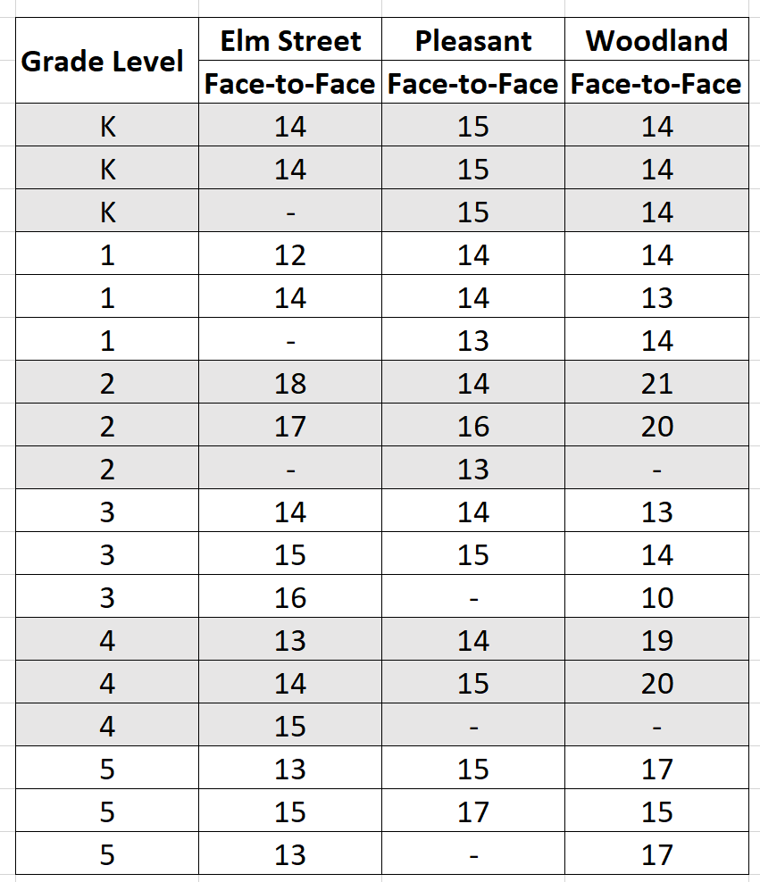
Quarter 2 Elementary Class Sizes

Slide 5
Remote Division

Slide 6
Remote Division: Elementary
Grade Level | Enrollment | Teacher
PreK | 7 | 1 (after school)
K | 15 | 1
1 | 18 | 1
2 | 15 | 1
3 | 21 | 1
4 | 22 | 1
5 | 20 | 1
Totals | 118 | 6 (plus one after school)

Slide 7
Remote Division: Middle and High
Middle
2 Staff
4 Additional Sections
1 Remote Teacher
1 Long-term Sub
High
2 Staff
4 Additional Sections
1 Long-Term Sub

Slide 8
Remote Division: Cost
Level | Funding Source | Quarter 2
 |  | Description | Amount
Elementary | Project Extra! | PreK After School | $3,375.00
 | General Budget (CARES) | 3 remote teachers | $20,250.00
MIddle | Project Extra! | 3 additional sections | $6,210.00
 | General Budget (CARES) | 1 additional section | $2,070.00
 |  | 1 remote teacher | $6,750.00
 |  | Long term Math sub | $9,945.00
High | General Budget (CARES) | 4 additional sections | $8,280.00
 |  | 1 long-term sub | $9,945.00
TOTALS |  |  | $66,825.00

Slide 9
Phasing-In Plan

Slide 10
Huot Technical Center
Opened to all students in the AREA and Newfound on October 5
Attendance has been over 75 percent
Transportation
Instruction
Franklin and Belmont - remote beginning October 13 (contact tracing)

Slide 11
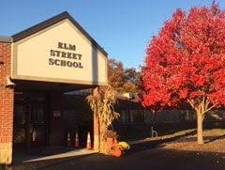
Phasing In: Elementary
October 19: Kindergarten
October 26: Grade 1
November 2: Grade 2
November 9: Grade 3
November 16: Grade 4 and 5 (note change)
Remote students coming back will phase in on November 16th.

Slide 12
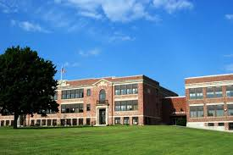
Phasing In: LMS and LHS
LMS
November 5: Grade 6
November 9: Grade 7
November 12: Grade 8
LHS
October 14: Grade 12
October 14-November 2: Grade 11 and 10
November 2: Grade 9

Slide 13
Logistical Considerations
Transportation
Snacks
Staffing
Quarantining scenarios
Mask and masks breaks
Some classes - size
Day cleaning
Facility use
Other

Slide 14
Critical Consideration
This “phasing in” plan is subject to change at anytime based on COVID - 19 conditions

Slide 15
COVID-19 Planning

Slide 16
COVID-19 Response Scenarios and Plans
New or unexplained symptoms
Close contact - confirmed case (cannot test out)
Close contact - suspected case
Travel outside New England (cannot test out)
Reported confirmed or suspected case to the school
New or unexplained symptoms in the school day
Investigation - suspected or confirmed case on school grounds

Slide 17
5 Steps: Positive COVID-19 Tests
Case interview
Identification of close contacts
10 minutes
Less than 6 feet
Isolation for people with COVID-19
Quarantine of close contacts (cannot test out)
Return to school
Quarantine
Student (Google Classroom)
Staff (Human Resources)

Slide 18
Plans for School Closure: Remote

Slide 19
Remote Learning Scenarios
Short term
COVID-19: Group, building, or district
Contact tracing
Staffing
Increase structure
Snow days
First two: Staff training, no school for students
After 2: Remote days
Long term considerations
Vacations
Flex day

Slide 20
Sample Remote Elementary Schedule
8:00-8:30 Morning Meeting
8:30-9:30 Literacy
9:30-10:30 Math
10:30-11:30 Social Studies/Science
11:30-12:00 Lunch
12:00-12:40 Exploratory
12:40-3:00 Team meetings / Teacher Work Time / Support for Students (times and days will vary)

Slide 21
Sample Remote Middle School Schedule
8:00-8:45 Period 1 (Grade 8 Exploratory) / Grade 8 Teacher Plan
9:00-9:45 Period 2 Exploratory Teacher Plan
10:00-10:45 Period 3 (Grade 6 Exploratory) / Grade 6 Teacher Plan
11:00-11:45 Period 4
11:45-12:15 LUNCH
12:15-1:00 Period 5 (Grade 7 Exploratory) / Grade 7 Teacher Plan
1:00-3:00 Office Hours, Small Group Instruction & Meetings

Slide 22
Sample Remote High School Schedule
Block 1 8:00 - 8:50
Block 2 9:10 - 10:00
SSB 10:20 - 11:00
Lunch 11:00 - 11:30
Block 3 11:40 - 12:30
Block 4 12:50 - 1:40
Teacher Office Hours 1:50 - 3:00

Slide 23
COVID-19 Data and
Public Health Guidance

Slide 24
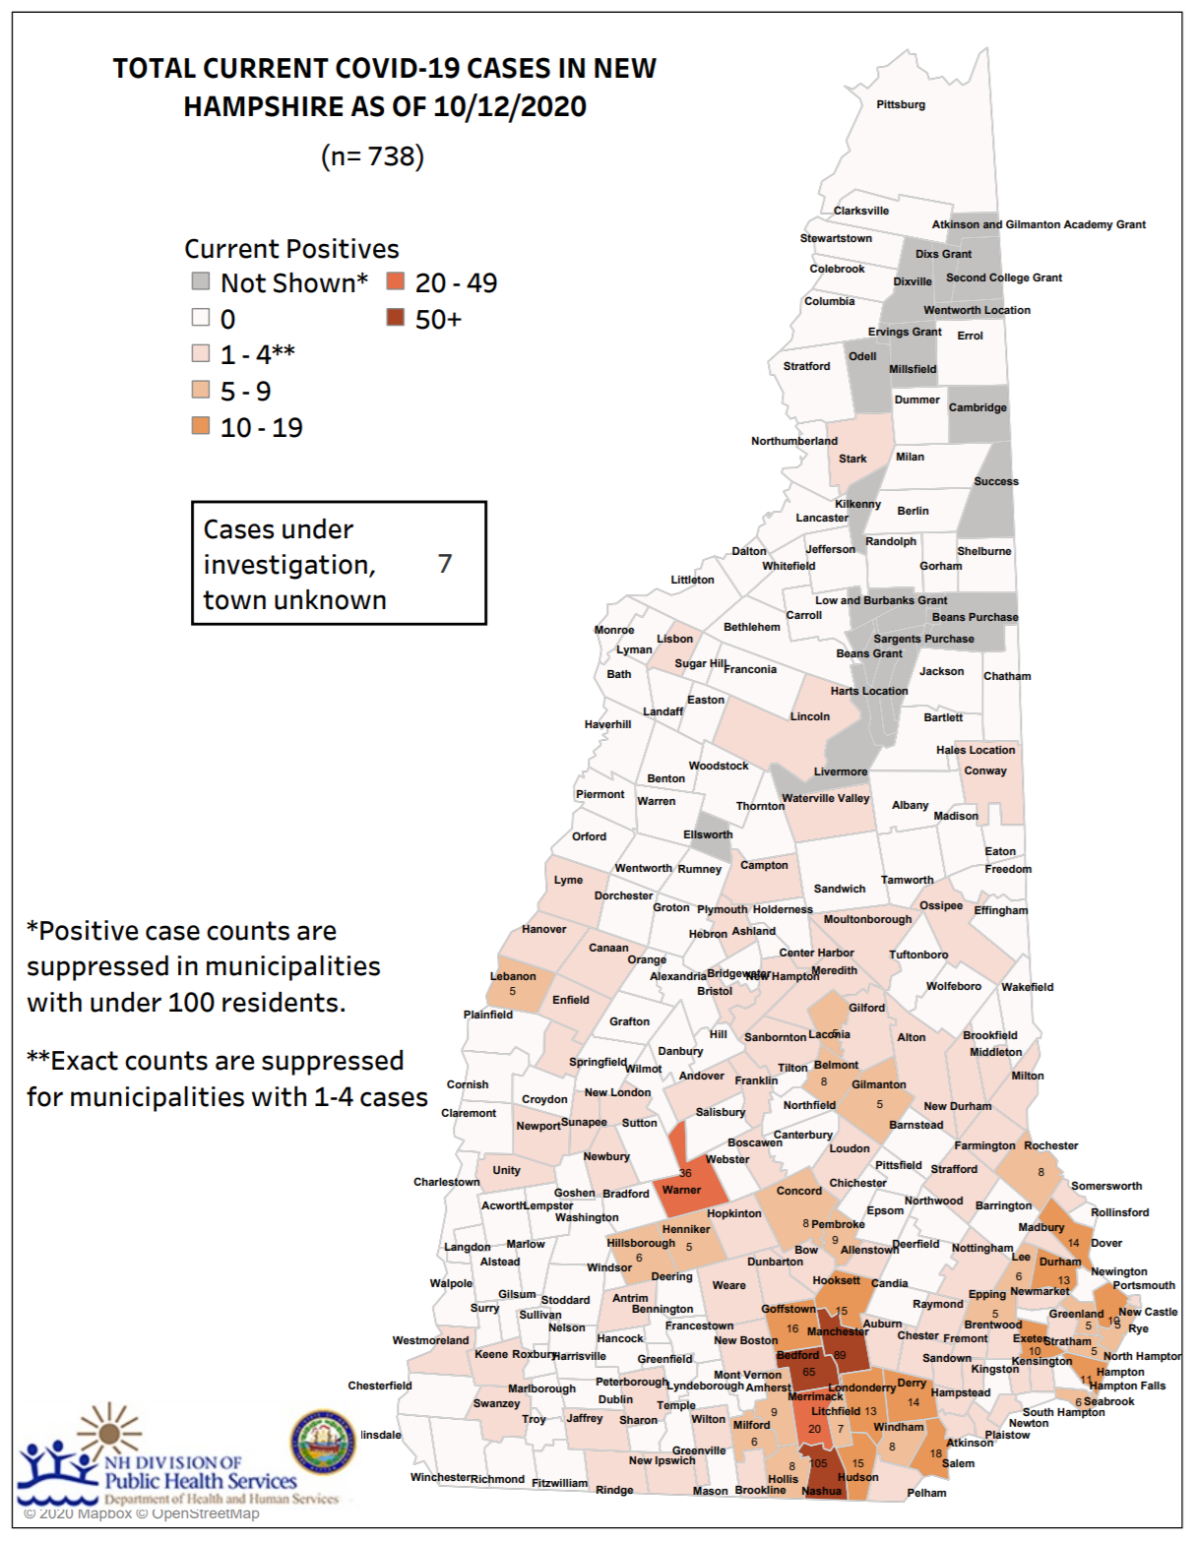
Laconia: 5 current cases as of October 12, 2020
(Source, NH-DHHS)

Slide 25
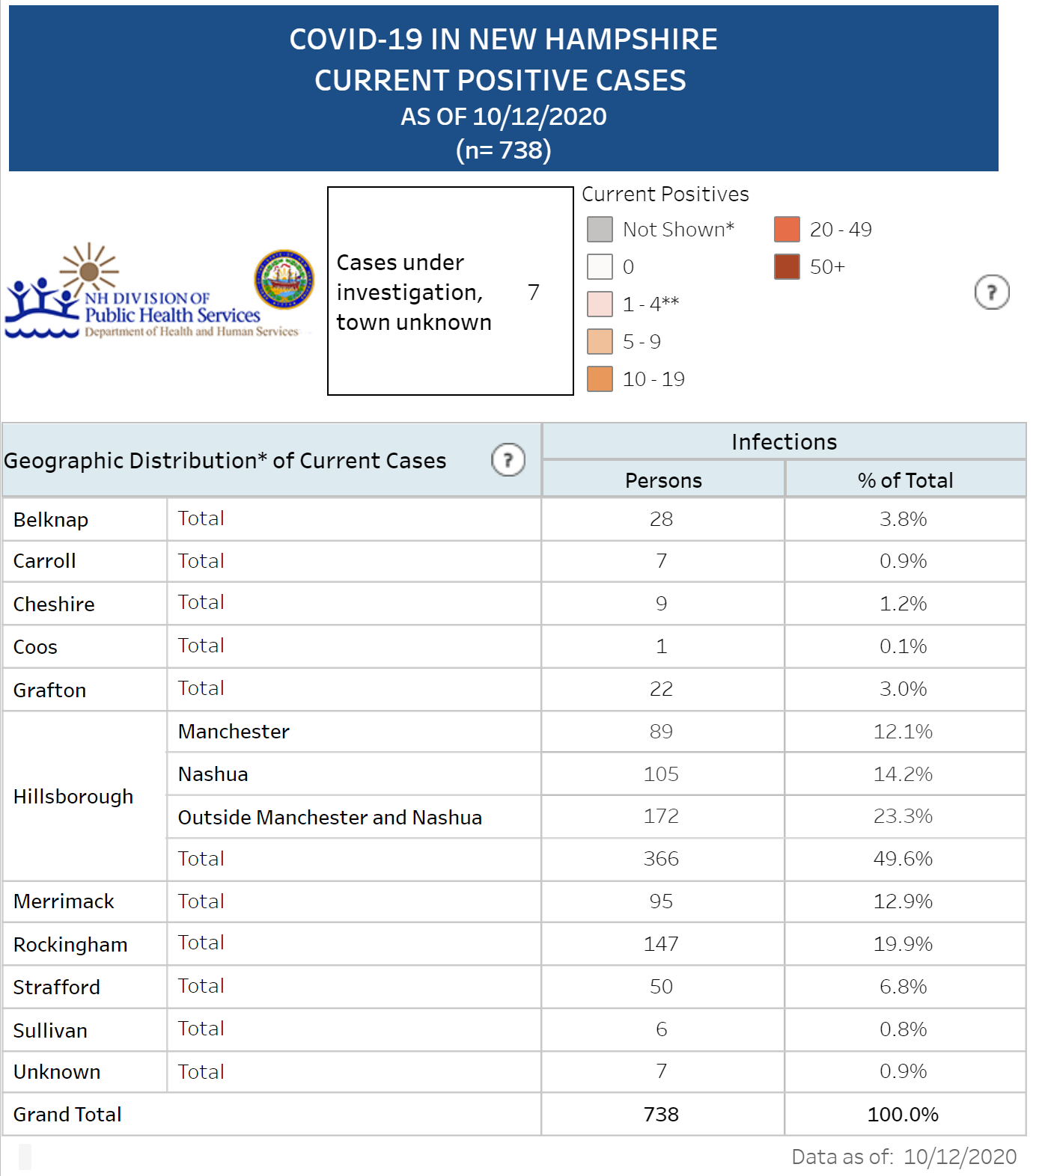

Slide 26
“Considerations for Transitioning Between School Instructional Models Based on Level of Community COVID-19 Transmission and Impact on Local Schools” (September 1, 2020)
See this document from the NH Division of Public Health Services, Bureau of Infectious Disease Control and the next three slides.

Slide 27
Community Transmission Guidance
Criteria | Level of Community Transmission
 | Minimal | Moderate | Substantial
COVID-19 PCR test positivity as a 7 day average | < 5% 0.4% in Belknap County (down from 0.5%) | 5 – 10% | >10%
Number of new infections per 100,000 population over prior 14 days | < 50 | 50-100 50.8 in Belknap County from Sept. 28 to Oct 11 - Population 61,303 | >100
Number of new hospitalizations per 100,000 people over the prior 14 days | < 10 1.6 in Belknap County (first new one in 67 days as of October 10) | 10-20 | >20

Slide 28
Determining Level of COVID-19 School Impact
Criteria | Level of School Impact
 | Low | Medium | High
Transmission in the school facility | Zero or sporadic cases with no evidence of transmission within the school setting | One cluster* in the school | Two or more unrelated clusters* in the school with onset (based on source case symptom onset dates) within 14 days of each other
Student absenteeism due to illness | <15% Rates in Laconia schools range between 6-9% | 15-30% | >30%
Staff capacity to conduct classes and school operations † | Normal | Strainted | Critical
* A cluster is defined as 3 or more individuals confirmed with COVID-19 who are part of a related group of individuals (e.g., classroom) who had the potential to transmit infection to each other through close contact.
† This subjective assessment should factor in a school’s ability to maintain adequate staff for facility operations, transportation, teaching, and administrative functions.

Slide 29
Decision Matrix for Transitioning Between Methods of Instruction
As of October 13, 2020
See the Community Level Transmission Metrics for Belknap County at NH-DHHS

Slide 30
Final Considerations
Current mitigation strategies continue to be important:
Screening
Physical distancing
Masks
Communication with Dr. Ben Chan
This “phasing in” plan is subject to change at anytime based on COVID - 19 conditions

